Slide 1



Slide 2
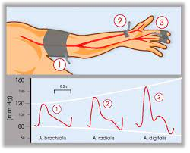
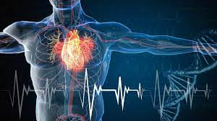

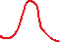

Slide 3
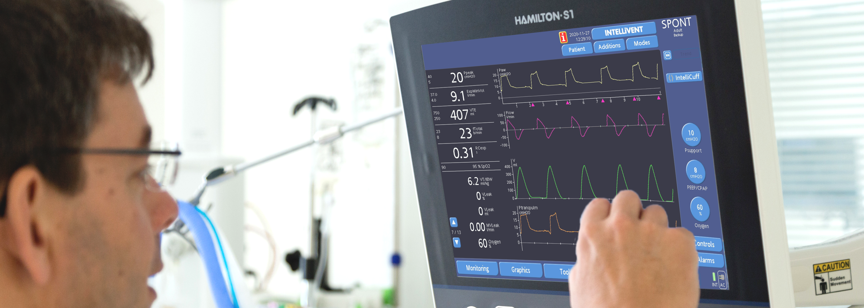
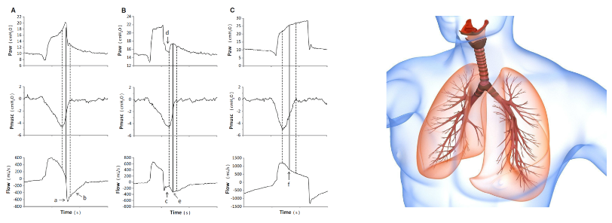

Slide 4

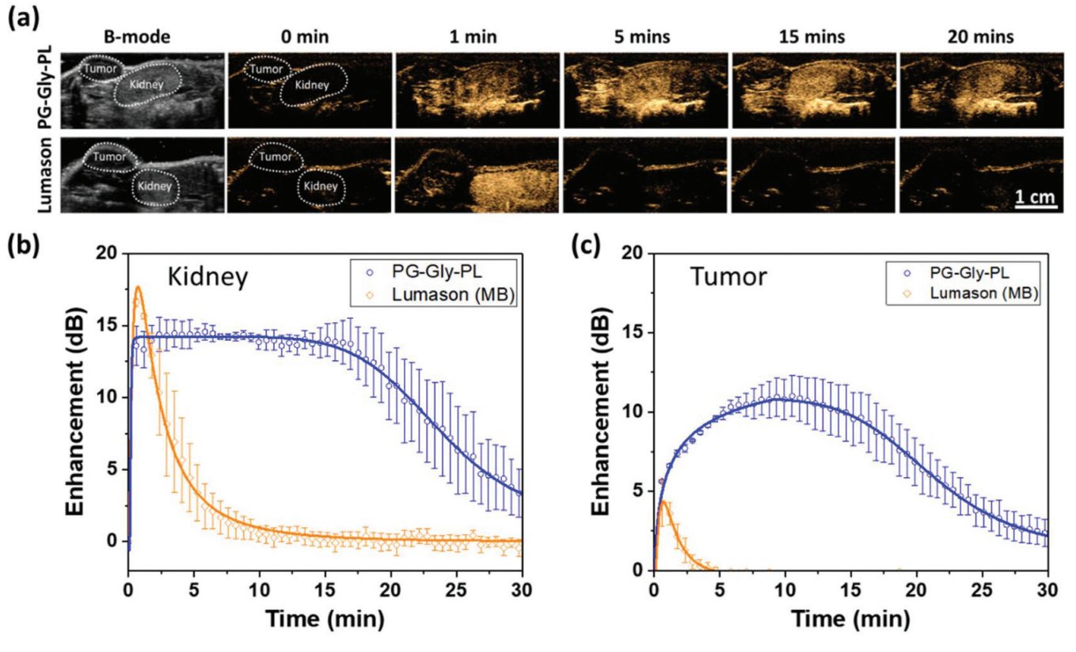
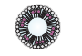
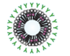

Slide 5
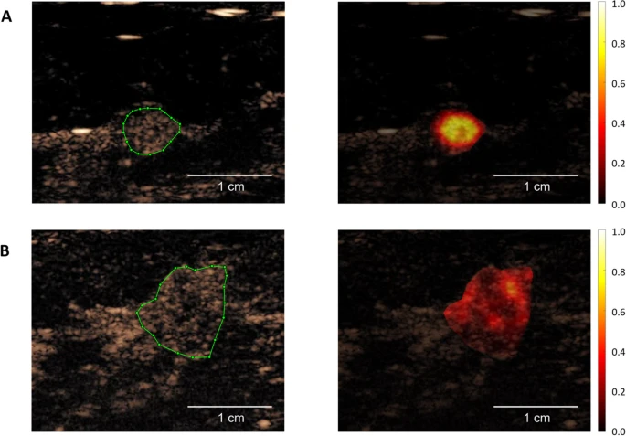
Benign
Malignant

Slide 6
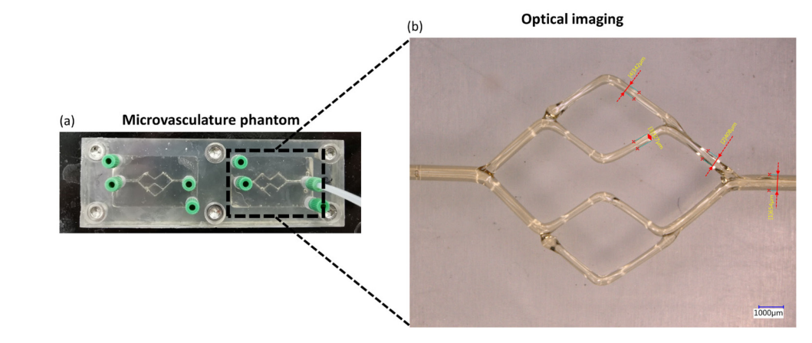
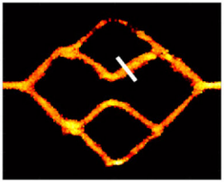
Superlocalization map

Slide 7
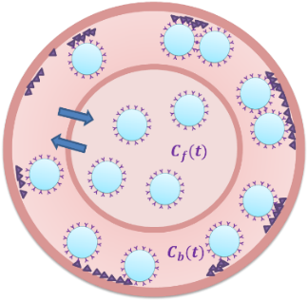
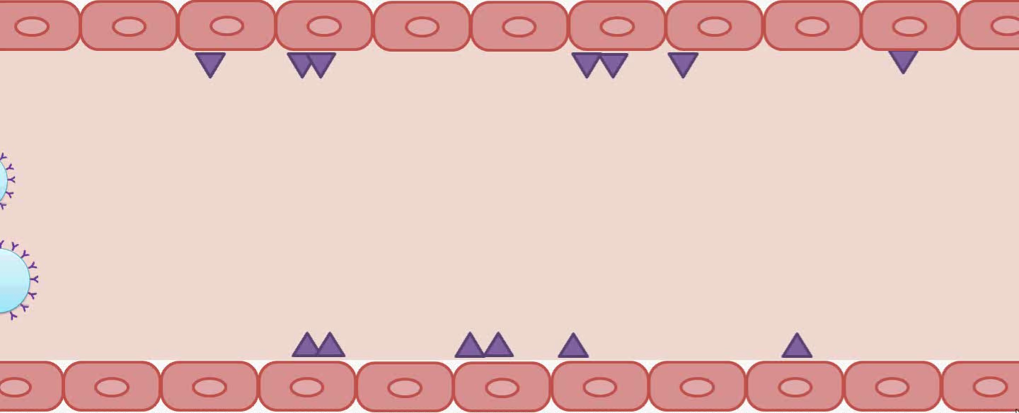


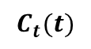
$$C_{f}(t)$$
$$C_{b}(t)$$
$$C_{t}(t)$$

Slide 8
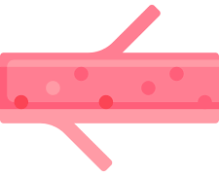
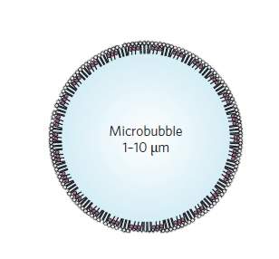
Microbubble
(1-10 μm)
Nanobubble
(~0.3 μm)

Slide 9
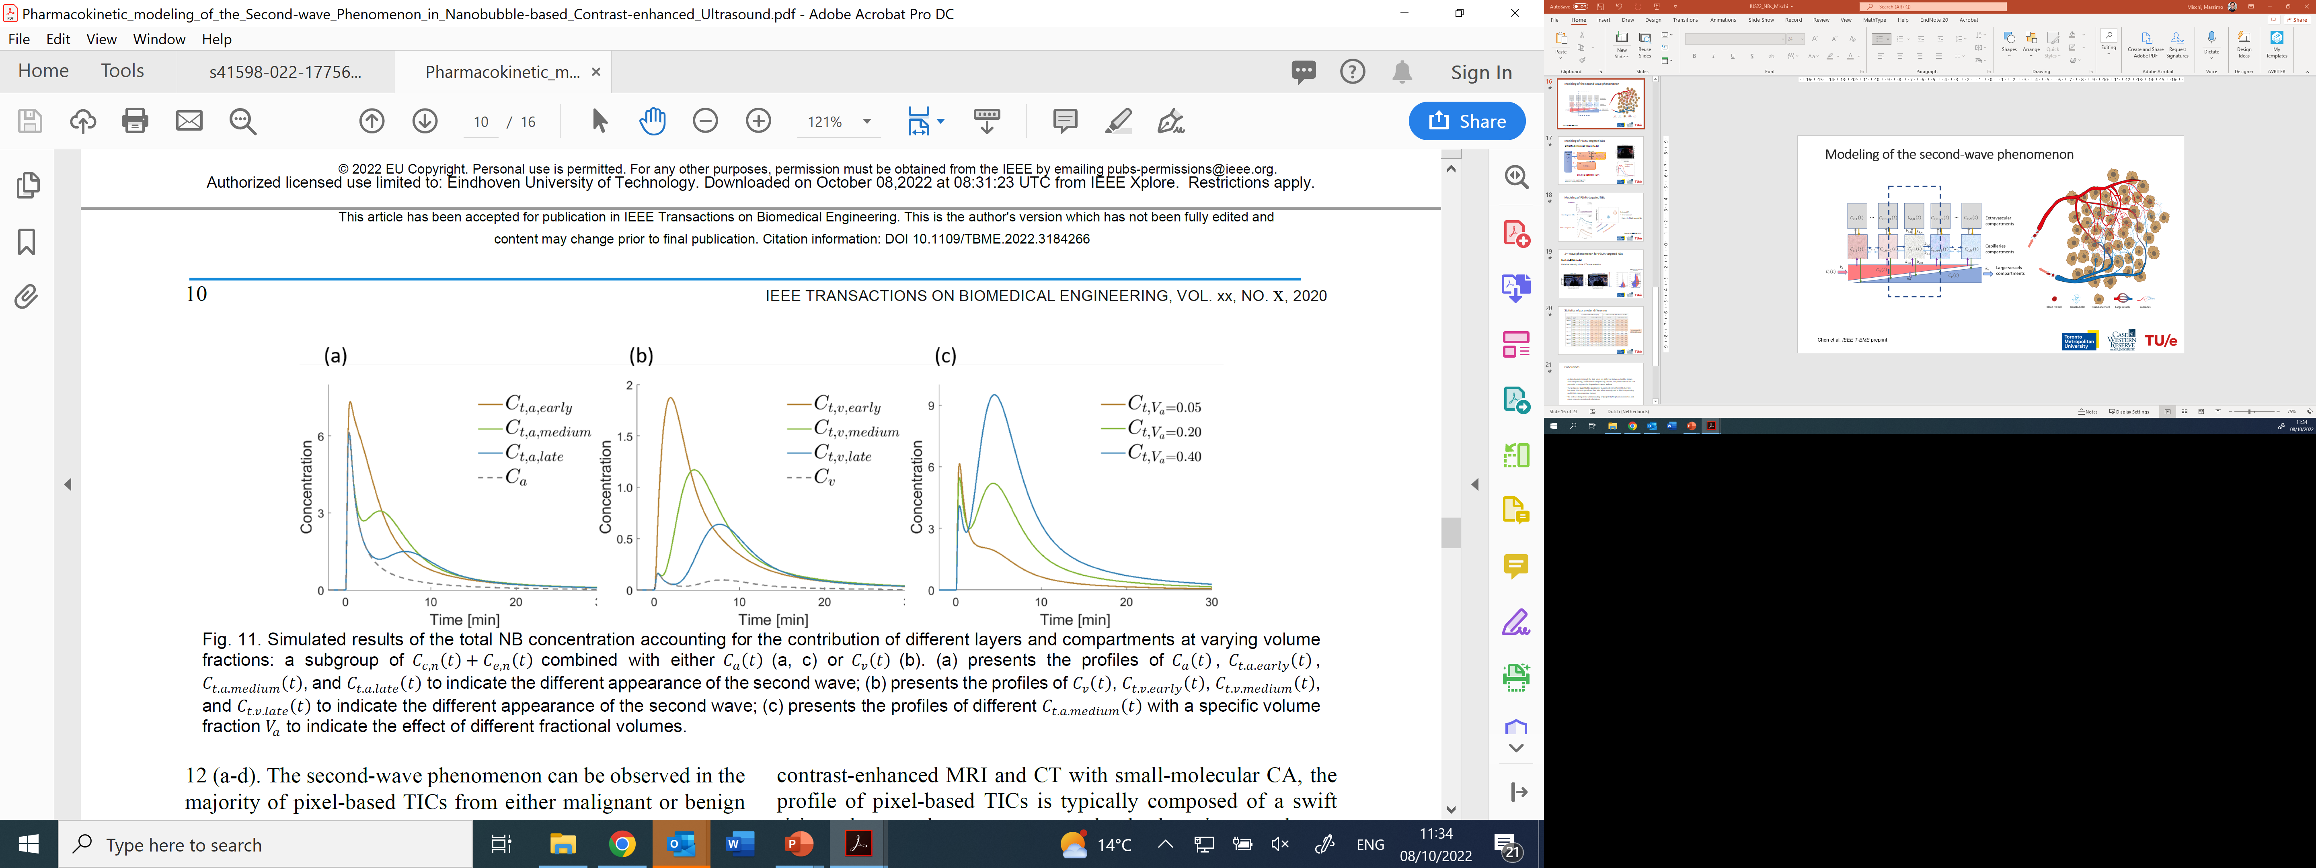
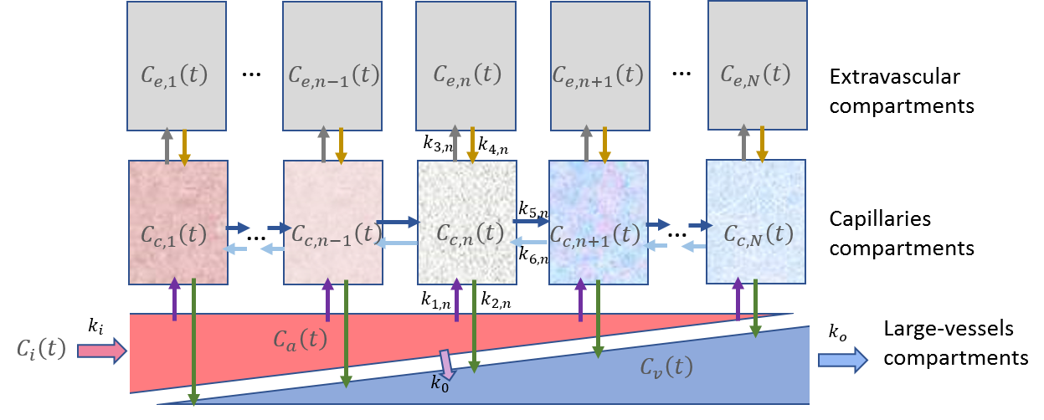

Slide 10
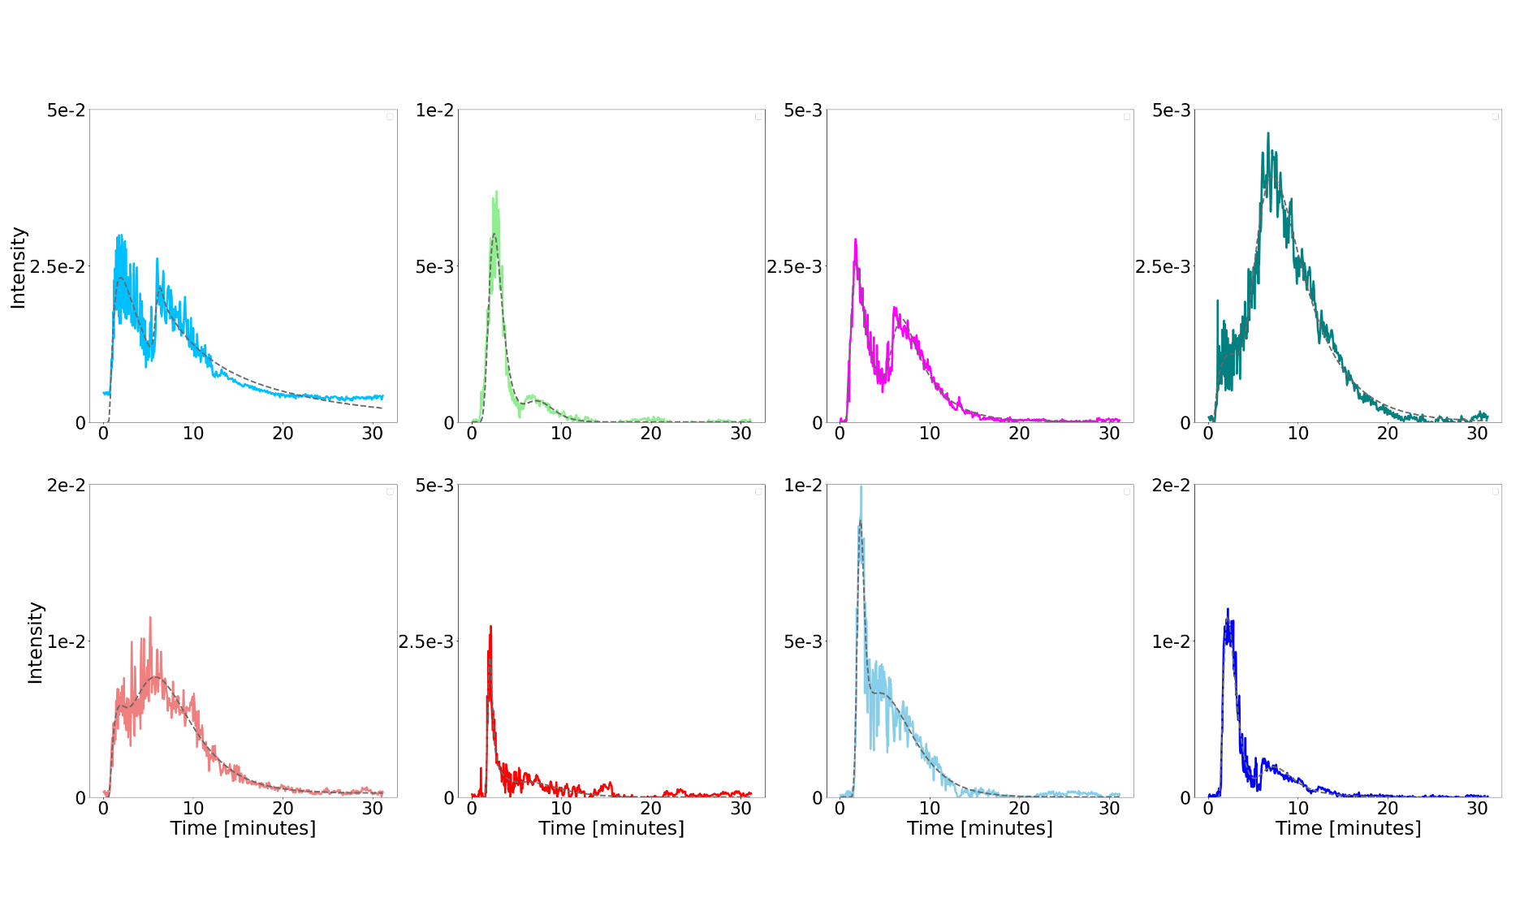
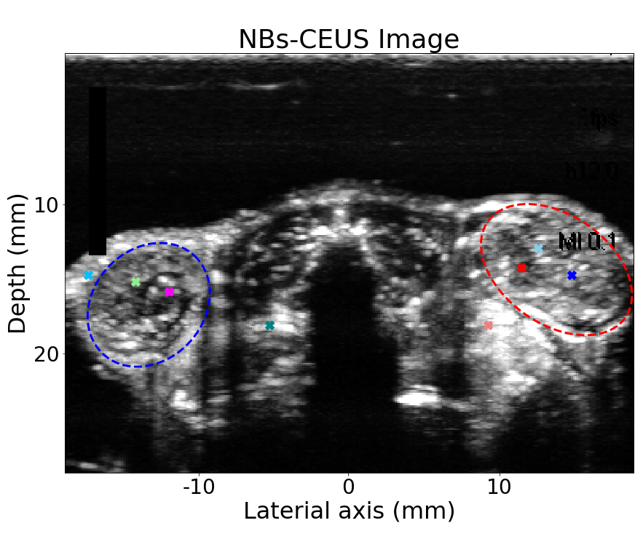
(free) NB-CEUS Image
Tissue
Left PC3flu
tumor
Left PC3flu
tumor
Tissue
Tissue
Right PC3pip
tumor
Right PC3pip
tumor
Right PC3pip
tumor

Slide 11
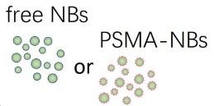
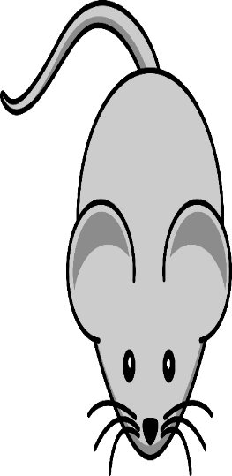
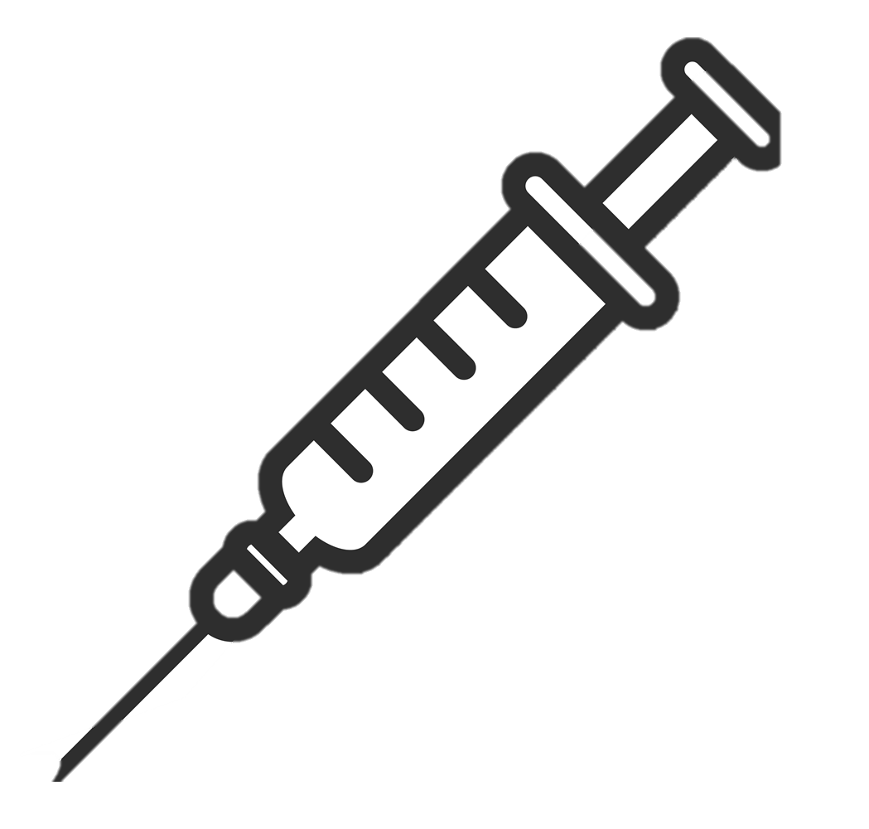

PSMA (+)
PC3pip tumor
PSMA (-)
PC3flu tumor
Kidneys
US imaging plane

Slide 12
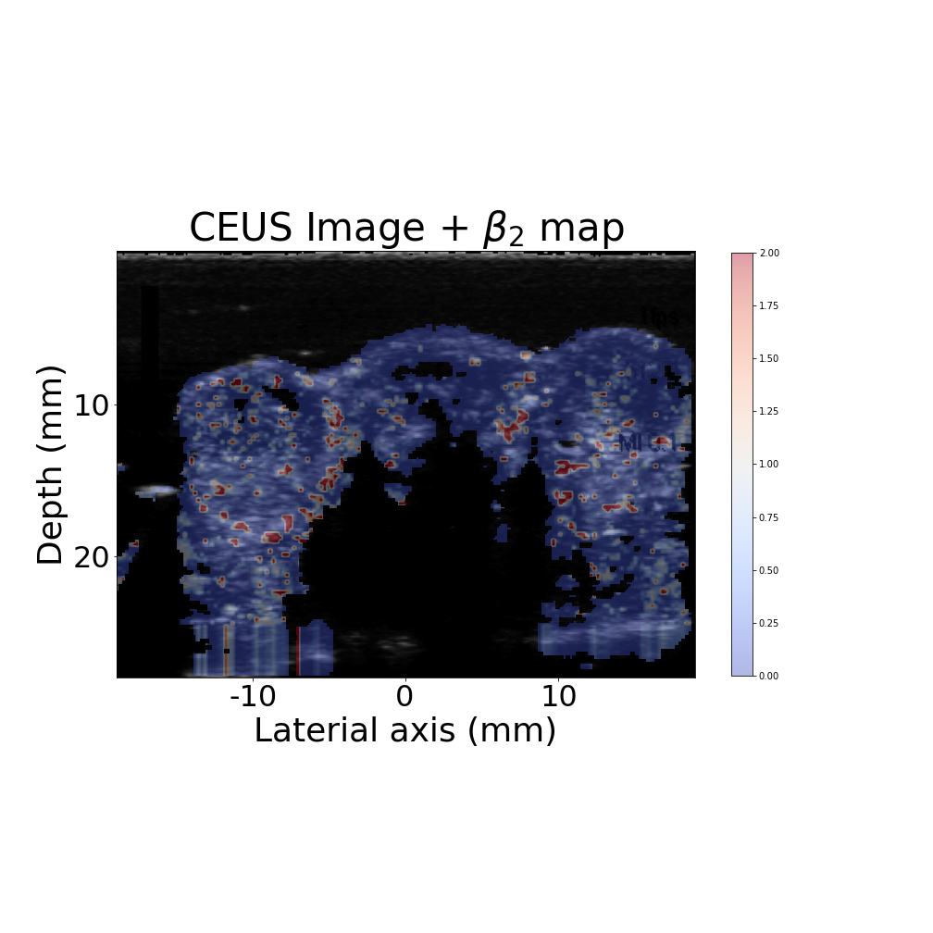
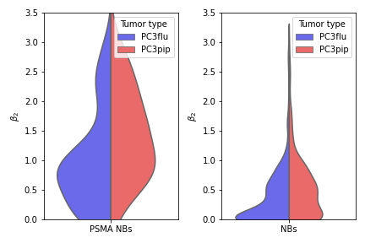
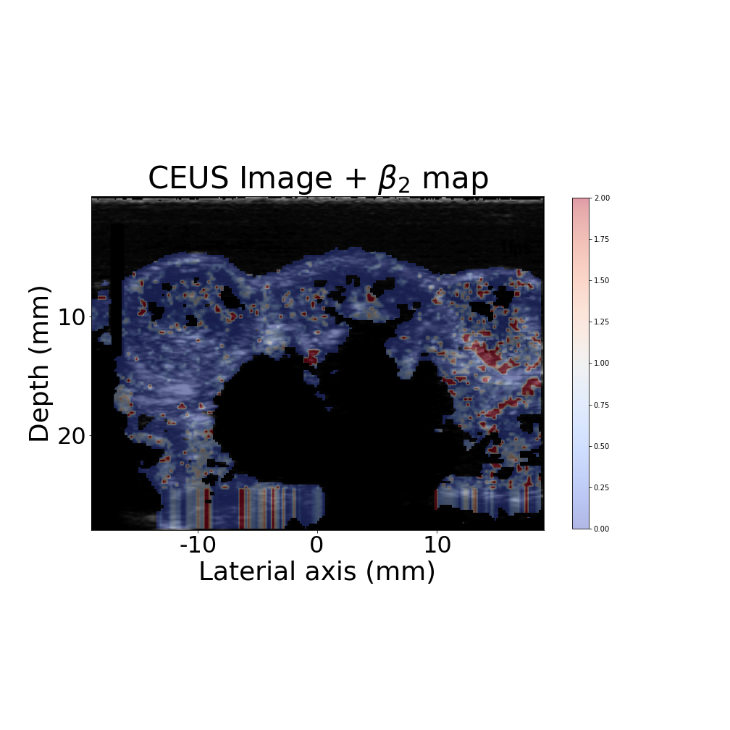
Relative intensity of the 2nd wave retention ($β_{2}$)
25% or 75% quartile value
Free NBs
Median value
PSMA-targeted NBs
2.00
PSMA+
PSMA-
PSMA+
PSMA-
1.00
0.00
Free NBs
PSMA-targeted NBs

Slide 13




Slide 14












Slide 15
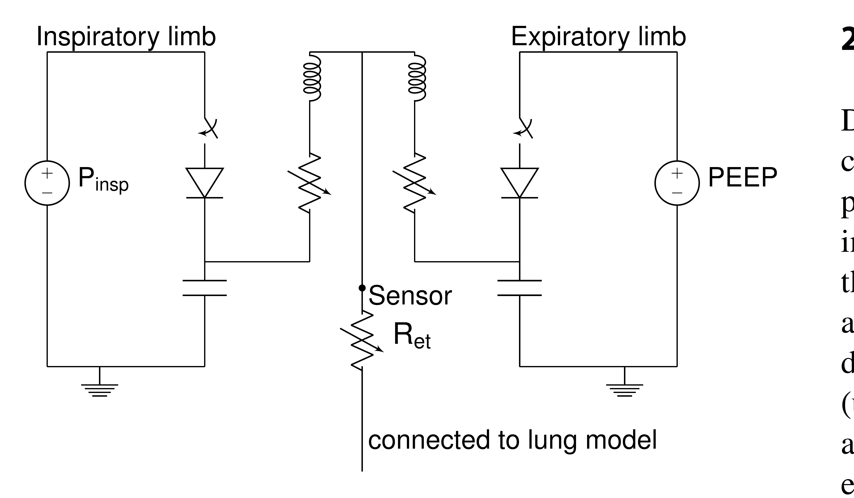
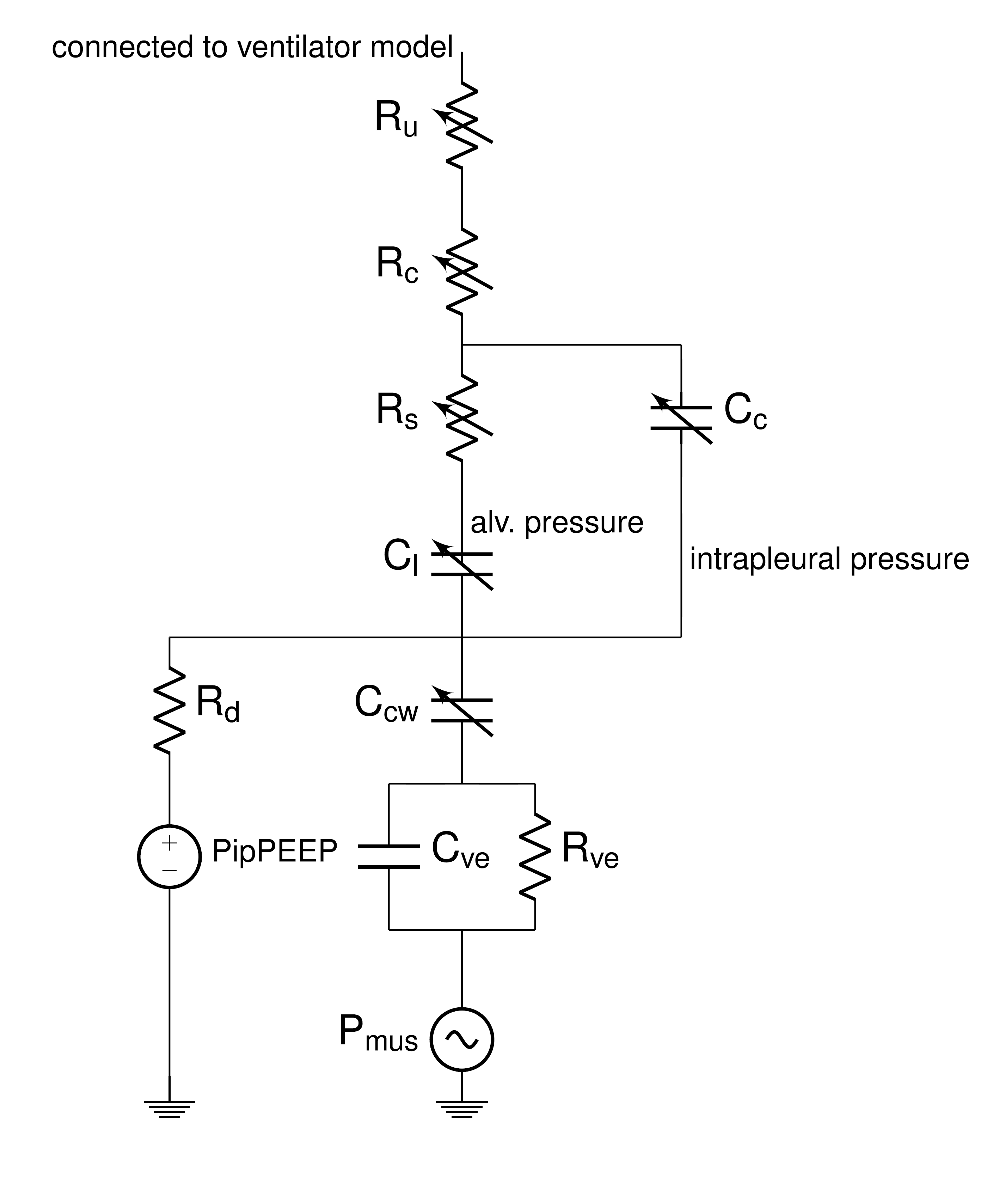
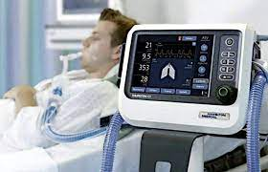

Slide 16
Input (Waveforms)
Output (softmax)
Contracting
layer
Expanding
layer
Convolution
4 x Contracting layers
4 x Expanding layers
Convolution
Upsampling (2)
Activation (elu)
Convolution
Activation (elu)
Concatenate
Convolution
Convolution
Convolution
Convolution
Convolution
Activation (elu)
Activation (elu)
Maxpooling (2)
Convolution
Dropout (0.5)
Activation (elu)

Slide 17
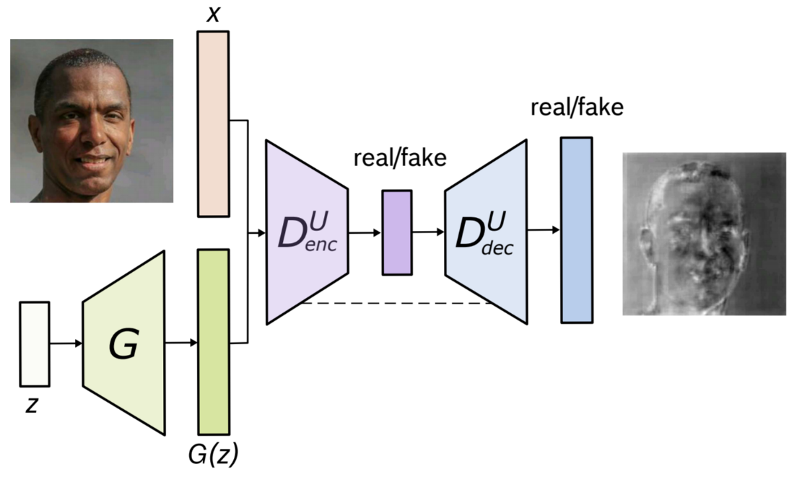
Generative adversarial networks (GANs)
More realistic
simulated data
(with labels)
Clinical data
(no labels)
Simulated data (with labels)

Slide 18







Slide 21



Slide 23
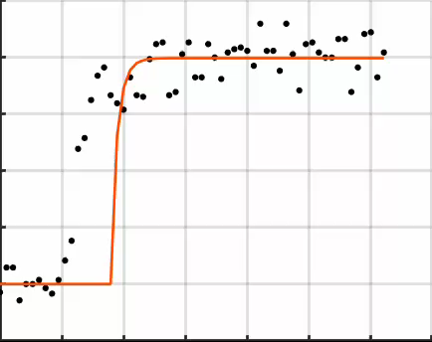
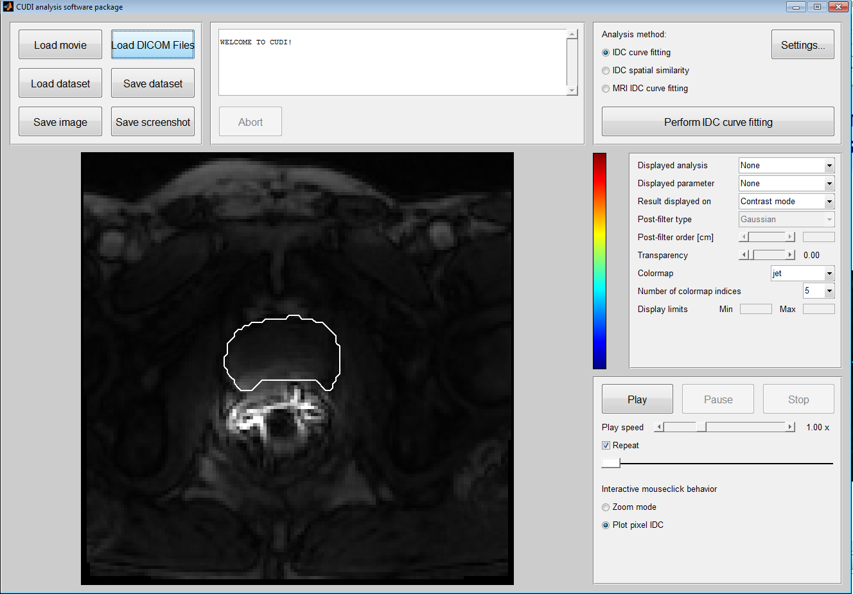
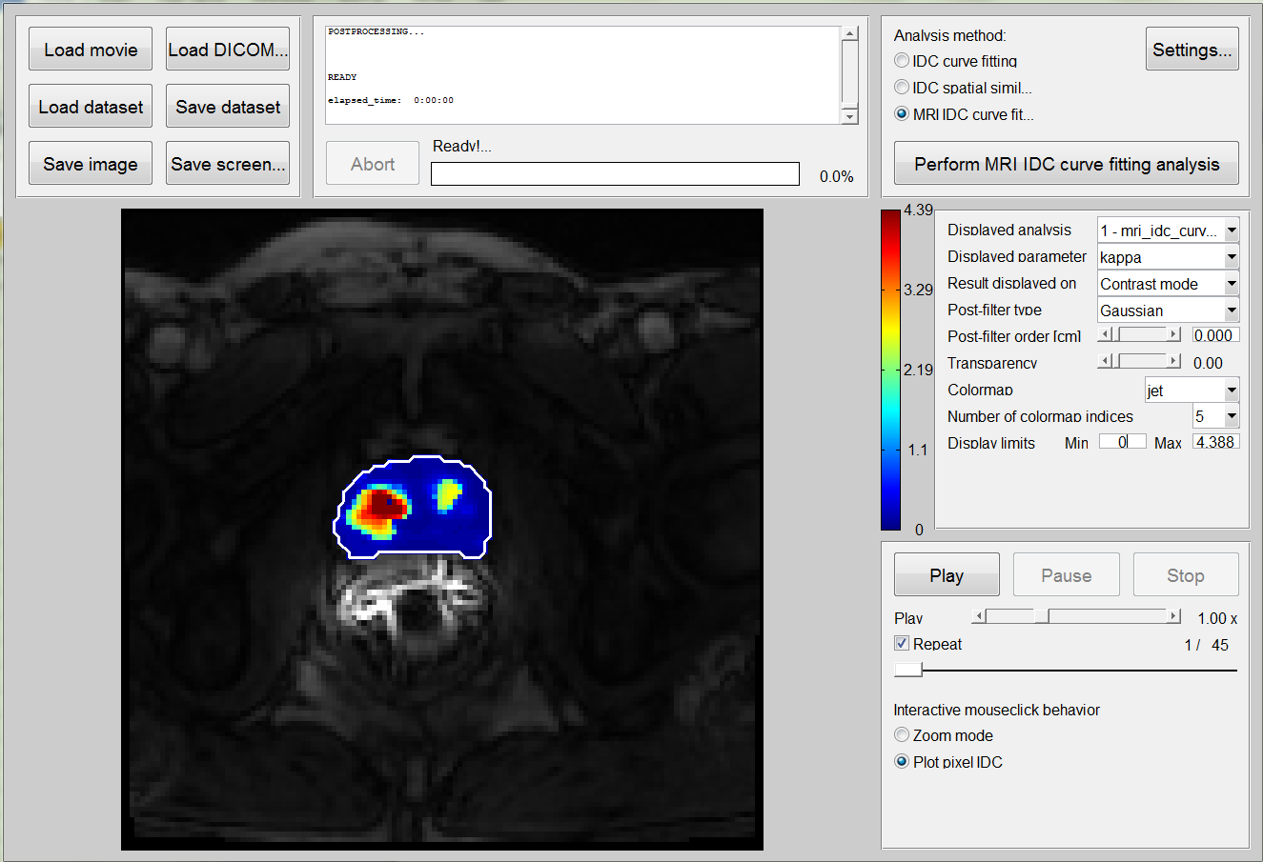
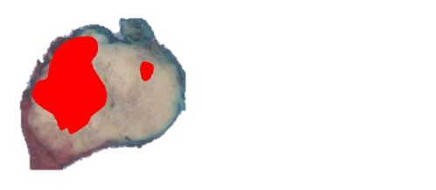
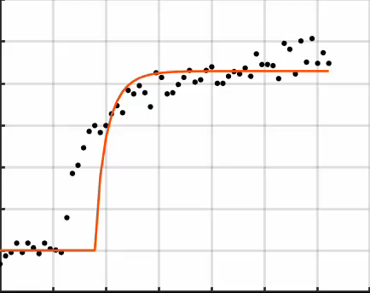
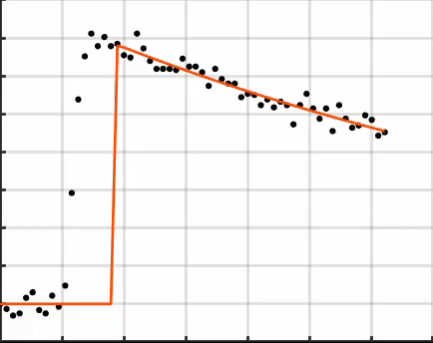
DCE-MRI
DISPERSION MODELING
DISPERSION MAPS
VALIDATION
Dynamic acquisition of multiple MR slices
(1 video per slice)
Assessment of microvascular architecture
Comparison
with histology
Iterative curve fitting
(per MR slice)

Slide 24
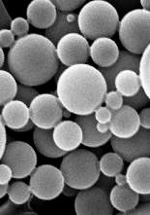
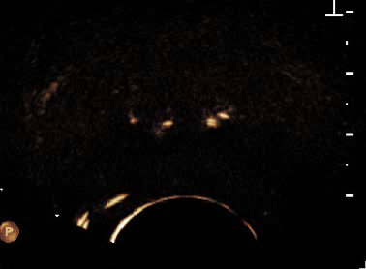
Dynamic Contrast Enhanced US (DCE-US)
Injection of Ultrasound Contrast Agents (UCA)
Time-intensity curve (TIC)

Slide 25
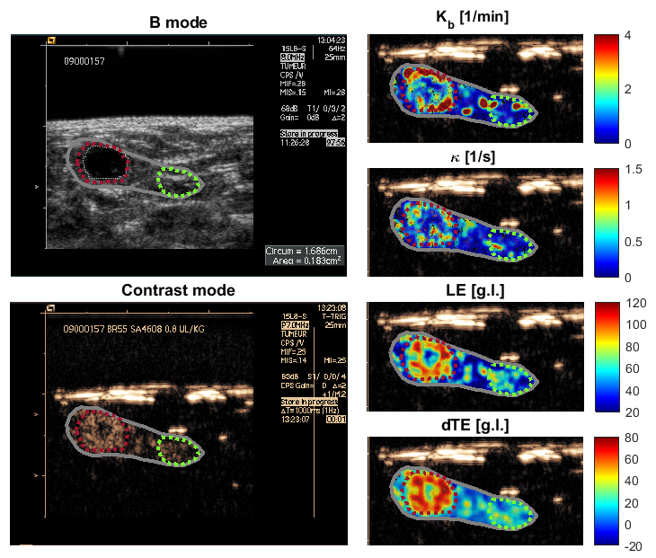
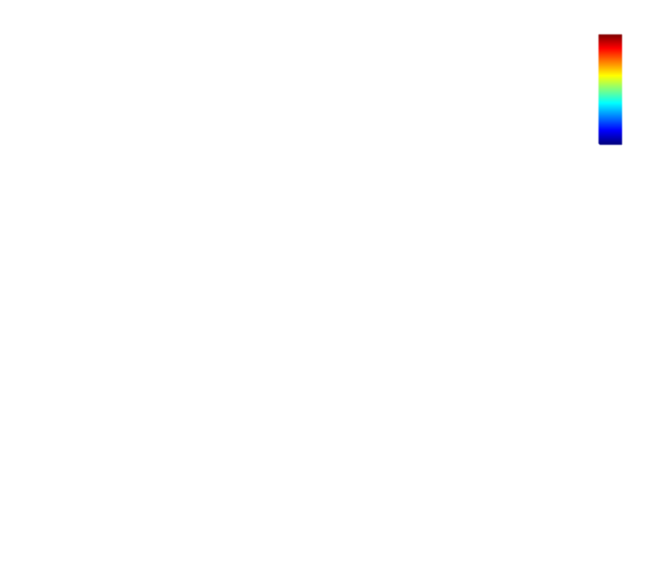
B-mode
Late-enhancement [g.l.]
120
Control
70
50
Tumor
20

Slide 27
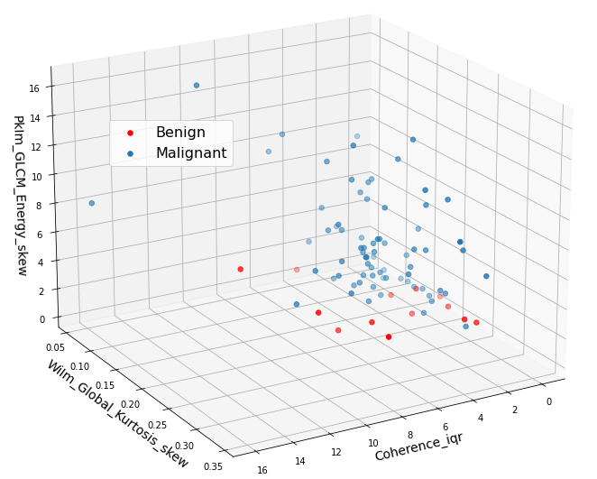
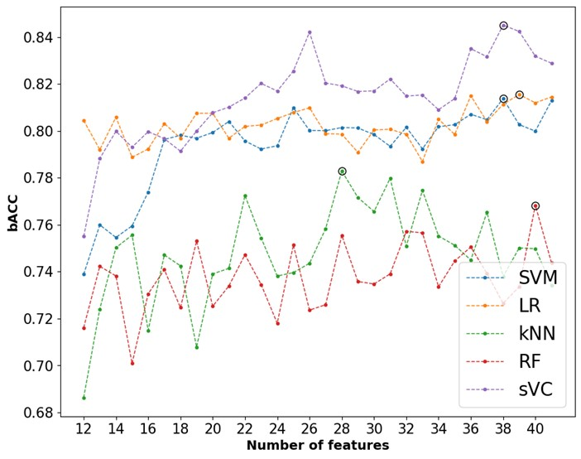

Slide 28
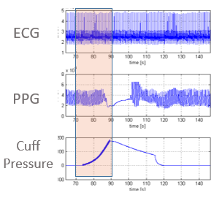
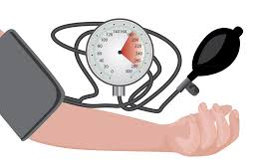
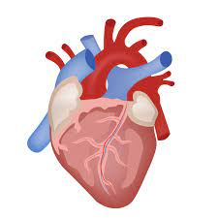
ECG
PPG
CUFF

Slide 29
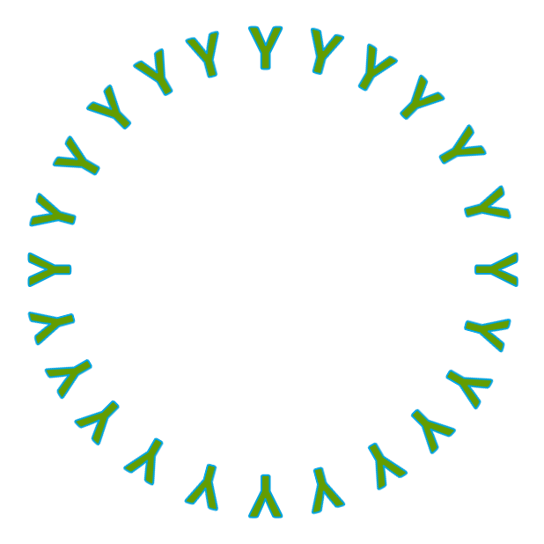
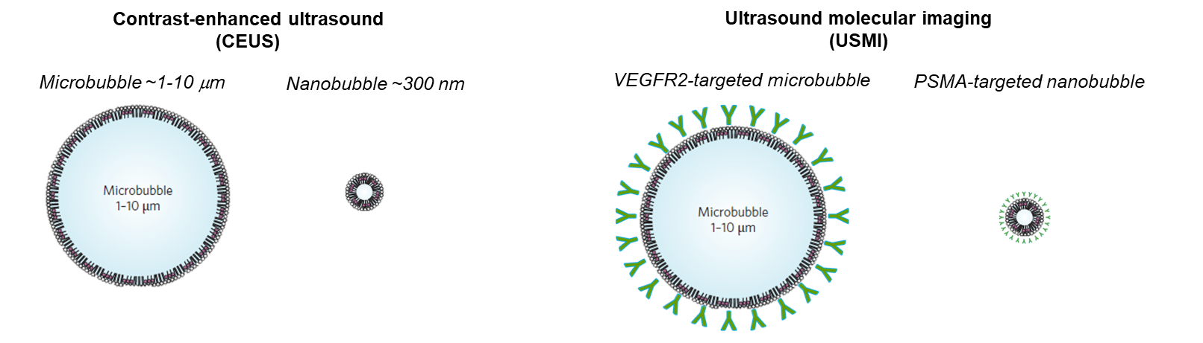
Contrast-enhanced ultrasound (CEUS)
Ultrasound molecular imaging
(USMI)
Microbubble ~1-10 μm
Nanobubble ~300 nm
VEGFR2-targeted microbubble
PSMA-targeted nanobubble

Slide 30



